Slide 1

Power BI Presentation on OTT Platforms
Sanjai Anbazhagan (1554)
Associate Technical Consultant
PD - Enterprise Analytics and Data Science

Slide 2



Data Visualization
Turning complex data into vivid visuals for swift comprehension.
Enhances decision-making, tells compelling stories, and explores trends.
Tools vary from charts to advanced platforms.
Introduction to Power BI
Power BI is a potent business intelligence tool enabling users to convert data into engaging dashboards.
The drag-and-drop functionality and interactive reports enable users to create compelling visualizations without extensive coding or technical skills.

Slide 3
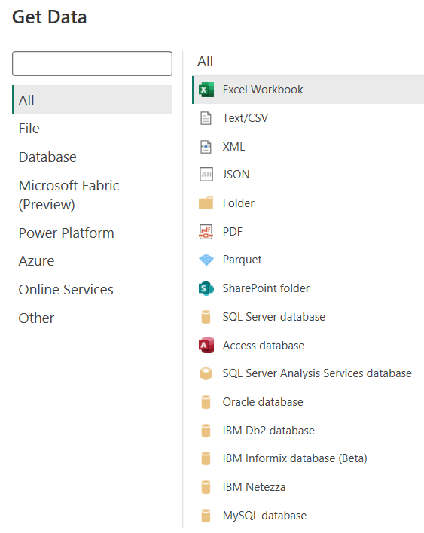

Data Sources
Power BI supports a wide array of data connectors, facilitating seamless integration with diverse sources.
Users can import and analyze data from Excel, SQL Server, SharePoint, Azure services, CSV files, web sources, social media platforms, Salesforce, and more.
This versatility empowers businesses to consolidate information from various environments for comprehensive analysis and reporting.
Its varied connectivity extracts insights from databases, cloud services, web scraping, and big data. It's a potent business intelligence tool, aiding informed decision-making.

Slide 4


Modes of Connection
Import Mode
Data is imported into internal model, allows extensive modeling.
Suitable for moderate sized datasets or scenarios with periodic updates.
Fast performance for analysis in Power BI.
Direct Query
Power BI queries the data source in real-time without importing data into the file.
Ideal for large datasets or real-time data needs, commonly used with relational databases.
Performance is influenced by the source system.

Slide 5


Data Modelling
Data modelling is the process of designing the structure and organization of data to enable efficient and meaningful analysis.
​By creating relationships between facts and dimensions, we can gain valuable insights and make informed decisions.
Fact
Dimension
Facts represent the numerical data or measurements that provide the basis for analysis.
Dimensions provide context and categorization to the facts, allowing for deeper analysis and filtering.

Slide 6

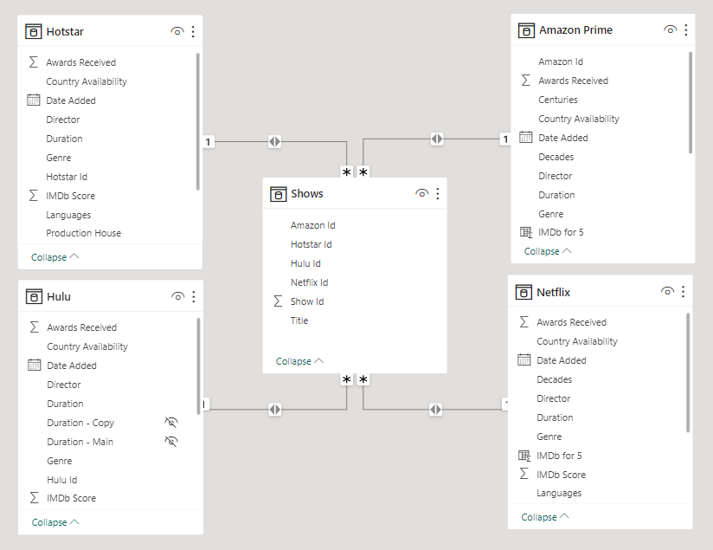
Star Schema
A popular data modeling approach, organizes dimensions around a central fact table, forming a star shape.
This design prioritizes simplicity, efficient query performance, and an improved user experience.
Widely used in data warehouses, the star schema is particularly advantageous for business intelligence.
Star schema's modular design integrates new dimensions and measures seamlessly, ensuring flexibility and scalability.

Slide 7





Types of Views
Report View
It provides a visualized representation of the data, enabling users to create reports.
Table View
It presents the data in a structured format, allowing users to analyze information by row.
Model View
It provides a comprehensive overview of the data model structure, allowing users to manage relationships.
DAX View
It allows us to create and run DAX queries. DAX expressions are used to define measures, columns, tables, and more.

Slide 8


Power Query
Power Query, a robust data transformation and cleansing tool, streamlines the preparation of data for integration into Power BI.
Its user-friendly interface enables effortless extraction, transformation, and loading of data from diverse sources like Excel files, CSVs, and databases.
The tool offers a suite of transformations, including filtering, sorting, merging, and splitting data, as well as functions like removing duplicates and adjusting data types.

Slide 9



Calculated Columns
Calculated Measures
Calculated columns are created in the data model and are used to add new data to a table.
They are based on a formula or expression that uses data from one or more columns in the same table.
Calculated columns can be used for a variety of purposes, such as creating new metrics or categorizing data.
Unlike calculated columns, measures are calculated on the fly and do not add new data to a table.
Measures can be used to create a wide range of calculations, such as sums, averages, and ratios.
They can also be used to create more complex calculations, such as year growth or running totals.

Slide 10



DAX Functions
DAX (Data Analysis Expressions) is a formula language facilitates the creation of custom calculations, allowing users to define complex calculations, manipulate data, and create dynamic measures.
CALCULATE can be used to modify the filter context of a calculation by applying one or more filters based on specific conditions or criteria.​
DATEDIFF calculates the difference between two dates, returning the result in a specified time unit.
IF ELSE conditional logic that returns one value if a condition is true and another value if it's false.
FIND & REPLACE locates the position of a substring within a text string and replaces it with another specified substring.

Slide 11


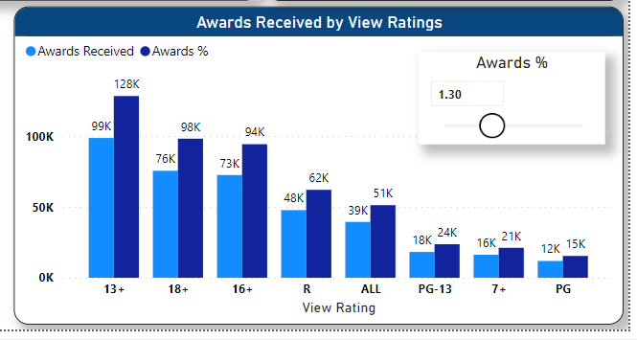
What If Parameter
Parameter that allows users to create and use parameters in their reports or dashboards to perform scenario analysis or sensitivity analysis.
These parameters enable users to dynamically change values in their visualizations, making it easier to explore different scenarios without the need to create multiple versions of the same report.

Slide 12



Bookmarks
Allow users to save the current state of a report, including filters, slicers and visualizations. This is particularly useful for when users want to compare different scenarios.
Selection
Feature that allows users to select data points in a visualization and have those selections automatically propagate to other visualizations on the same page.

Slide 13



Performance Analyzer
Tool that allows you to analyze the performance of reports and dashboards. It provides a detailed breakdown of the time taken to execute each query and visualization in your report.
Sync Slicer
Sync Slicer allows simultaneous filtering across multiple report pages, ensuring consistent data selection. Changes made to a slicer on one page automatically reflect on others.

Slide 14



Drill Down
Enables interactive exploration of detailed data in visuals, breaking down aggregated information to reveal hierarchical structures.
Enhances user experience with a user-friendly interface for navigating data layers, simplifying the comprehension of complex datasets.
Drill Through
Enables users to navigate between reports for detailed analysis, providing additional context through linked reports for a comprehensive understanding.
Empowers users to customize exploration by selecting specific aspects, tailoring the analysis to individual needs.

Slide 15


Custom Visuals
Custom visuals, empower users to integrate third-party or custom-built visualizations, expanding beyond default charts for more tailored and insightful data representations.
The Tornado chart is ideal for illustrating the impact or variance of various categories on a single measure, streamlining comparative analysis.
The Rating visual enhances user engagement by enabling the incorporation of star ratings or other scoring systems, fostering a more interactive reporting experience.

Slide 16




Data Security in Power BI
Row Level Security
It enables the restriction of data access at the row level based on user roles. This ensures that sensitive data is only accessible by authorized personnel.​
Audit Logging
Enable audit logging to track user activities, providing insights into who accessed what data and when.
Data Masking​
To conceal portions of sensitive data, displaying only relevant information to users based on their access permissions.​

Slide 17





Power BI Licensing
Power BI Free
This is the basic, free version of Power BI with no associated licensing costs. Limited in terms of collaboration features and sharing capabilities.
Power BI Pro
Paid subscription for individual users allowing collaboration, sharing and extra features. Enables scheduled data refresh and access to premium content sharing features.
Power BI Premium
Designed for larger organizations with more extensive data needs, offering dedicated cloud capacity. Supports more frequent scheduled refreshes, including options for high-frequency refreshes throughout the day.
Power BI Embedded
For developers embedding Power BI reports and dashboards in custom applications. Offers flexibility for embedding scenarios with varying data refresh needs.

Slide 18


Data Refresh
The process of updating the data in Power BI reports, dashboards, and datasets to ensure that the displayed information reflects the most current and accurate data from the underlying data sources. This is essential for maintaining the relevance and validity of insights.
Scheduled Refresh
Power BI allows users to schedule automatic data refreshments at specific intervals for datasets.
Manual Refresh
Users can manually trigger a refresh to get the latest data when needed.

Slide 19

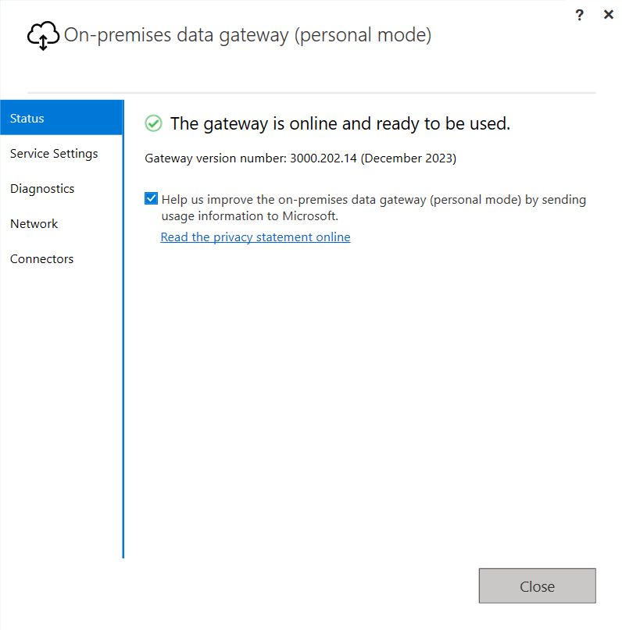
Gateway in Power BI
Gateway seamlessly transfers data between on-premises sources and Power BI cloud, ensuring secure connectivity.
It automates scheduled data refreshes for up-to-date reports and dashboards, while also supporting real-time data connectivity for accessing current information from on-premises sources with Power BI's cloud-based benefits.
Types of Gateways
On-premises Data Gateway
Designed for use by multiple users and can be installed on a server.​
Personal Mode Gateway
Intended for individual use and installed on a user's machine.​

Slide 20


Thank You!
Your feedback matters. If you have any questions, feedback, or suggestions, please feel free to reach out.

